Slide 1
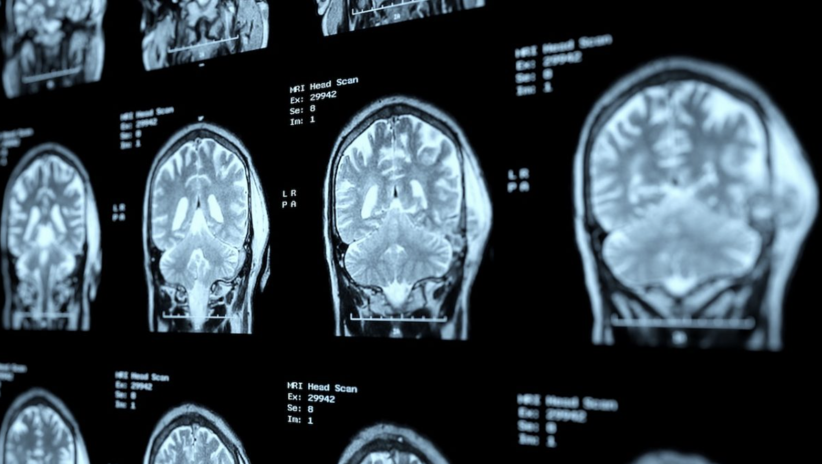
AD Image Classification Project with Machine Learning
QBS 101.5 | Summer 23
Prepared by: Freya Ma

Slide 2











01
Machine Learning and Applied Machine Intelligence in real life
Machine learning is a subfield of artificial intelligence (AI) that focuses on developing algorithms and techniques that enable computers to learn from and make predictions based on provided data.
Machine learning
Machine learning is widely used in healthcare, finance, retail and E-Commerce, marketing, manufacturing, entertainment and media, agriculture, environmental sciences and etc.

Slide 3

02
Alzheimer’s disease (AD) is the fifth-leading cause of death among people over the age 65
Alzheimer’s disease (AD), a neurodegenerative disorder potentially caused by the development of beta-amyloid plaques in the brain, is the most common form of dementia and the fifth-leading cause of death among people over the age of 65.
With brain MRI scans, healthcare providers and researchers have the opportunities to detect brain abnormalities associated with mild cognitive impairment and can use these scanned images to visualize any potential shrinkage of the hippocampus.
Source: UAB medicine
This project aims to utilize machine learning to analyze brain MRI scans and identify patterns associated with Alzheimer’s disease.
The objective is to create an image classification model by extracting meaningful features from MRI images and training a Convolutional Neural Network (CNN) model to differentiate between healthy and disease-affected brains.
The designed model will be trained to learn spatial patterns and relevant features from the MRI data, enabling accurate and time-efficient generalization to new, unseen MRI scans.

Slide 4
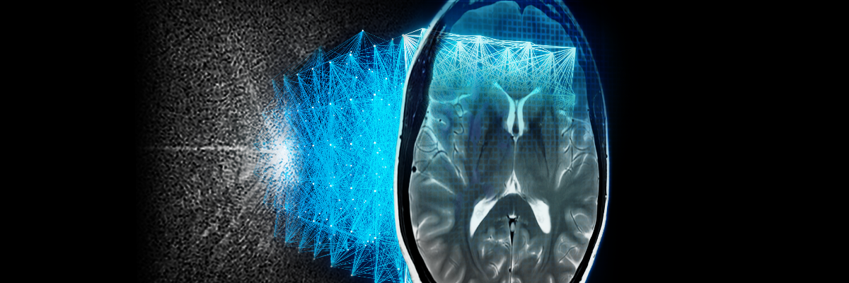
03
High accuracy rates demonstrated in prior works have shown promising outcomes
Prior work (by Liu et al.):
In early 2015, Liu et al. have proposed an inherent structured-based multi-view learning method (ISLM) for AD classification. It mainly involves:
Multi-view feature extraction using multiple templates and gray matter tissues as tissue-segmented brain image for feature extraction;
Subclass clustering-based feature selection through using voxel selection;
Use a support vector machine (SVM) based ensemble classification.
The experiment result shows that proposed ISML method obtains an accuracy of 93.83% and specificity of 95.69%, and sensitivity of 92.78% for AD vs. normal controls.
Source: GE HealthCare
Transfer Learning with ResNet-50:
In 2022, AlSaeed and Omar proposed to apply transfer learning on a pre-trained AD diagnosis model ResNet50.
Tested on the ADNI and MIRIAD dataset and concluded that the model with Softmax classifier outperforms SVM and RF in all performance measures with an accuracy range of 85.7% to 99% for models with MRI ADNI dataset.
Believed that a transfer learning approach using CNNs could be used to develop a low-cost and non-invasive diagnostic tool for Alzheimer’s disease.

Slide 5
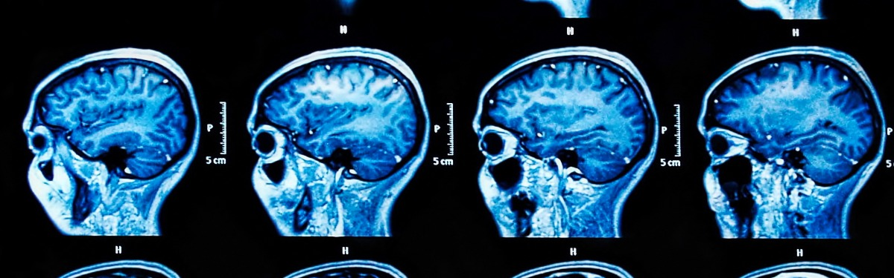
04
High accuracy rates demonstrated in prior works have shown promising outcomes
Key
Takeaways
Source: National Institute for Health and Care Research
Lesson learned and potential future steps:
Documentation
Model selection and hyperparameter tuning
Real-world applicability & Ethical and privacy considerations
Next Steps:
Handling dataset/class imbalance (Techniques like oversampling, under sampling, or using different evaluation metrics should be considered to address in the future)

Slide 6
Q&A

Slide 7
References: AlSaeed D, Omar SF. Brain MRI Analysis for Alzheimer's Disease Diagnosis Using CNN-Based Feature Extraction and Machine Learning. Sensors (Basel). 2022 Apr 11;22(8):2911. doi: 10.3390/s22082911. PMID: 35458896; PMCID: PMC9025443. Liu M., Zhang D., Adeli E., Shen D. Inherent Structure-Based Multiview Learning With Multitemplate Feature Representation for Alzheimer’s Disease Diagnosis. IEEE Trans. Biomed. Eng. 2016;63:1473–1482. doi: 10.1109/TBME.2015.2496233 Rasmussen J, Langerman H. Alzheimer's Disease - Why We Need Early Diagnosis. Degener Neurol Neuromuscul Dis. 2019 Dec 24;9:123-130. doi: 10.2147/DNND.S228939. PMID: 31920420; PMCID: PMC6935598. Kavitha C, Mani V, Srividhya SR, Khalaf OI, Tavera Romero CA. Early-Stage Alzheimer's Disease Prediction Using Machine Learning Models. Front Public Health. 2022 Mar 3;10:853294. doi: 10.3389/fpubh.2022.853294. PMID: 35309200; PMCID: PMC8927715. 2022 Alzheimer's disease facts and figures. Alzheimers Dement. 2022 Apr;18(4):700-789. doi: 10.1002/alz.12638. Epub 2022 Mar 14. PMID: 35289055.

Slide 8
Thank you!

